Slide 1
COMP607 – Basic Cryptography
Course lecturer – Raymond Lutui

Slide 2
Symmetric Cryptographic Algorithms
Symmetric cryptographic algorithms
Use the same single key to encrypt and decrypt a message
Also called private key cryptography
Stream cipher
Takes one character and replaces it with one character
WEP (Wired Equivalent Protocol) is a stream cipher – wireless
Substitution cipher
The simplest type of stream cipher
Simply substitutes one letter or character for another

Slide 3
Symmetric Cryptographic Algorithms
Common algorithms include
Data Encryption Standard (DES)
Triple Data Encryption Standard (3DES)
Advanced Encryption Standard (AES)

Slide 4
Stream Cipher vs Block Cipher
Encrypting information bit-by-bit. A stream cipher, on the other hand, breaks a plaintext message down into single bits, which then are converted individually into ciphertext using key bits.
Encrypting information in chunks. A block cipher breaks down plaintext messages into fixed-size blocks before converting them into ciphertext using a key.
Stream ciphers are less secure because the engine that generates the stream does not vary; the only change is the plaintext itself. Block ciphers are considered more secure because the output is more random, particularly because the cipher is reset to its original state after each block is processed.

Slide 6
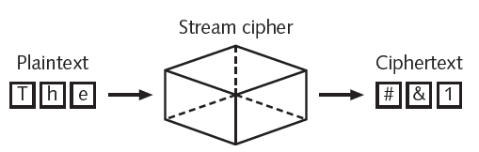
Figure 11-7 Stream cipher
© Cengage Learning 2012

Slide 7
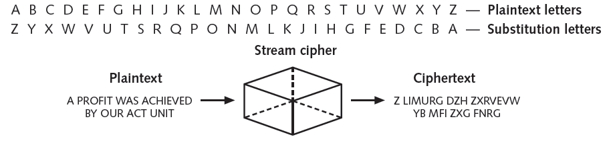
Homoalphabetic substitution cipher
Single plaintext character mapped to multiple ciphertext character
Figure 11-8 Substitution cipher
© Cengage Learning 2012

Slide 8
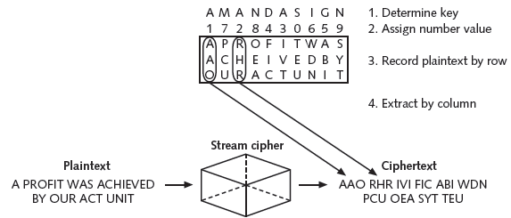
Transposition cipher
Rearranges letters without changing them
Figure 11-9 Transposition cipher
© Cengage Learning 2012

Slide 9
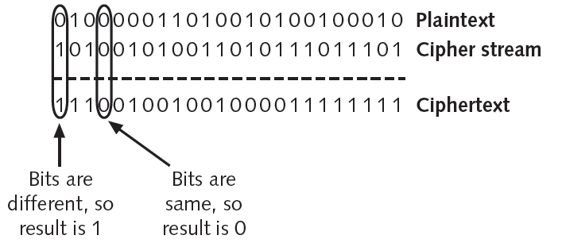
Final step in most symmetric ciphers
Combine cipher stream with plaintext to create the ciphertext
Figure 11-10 Combine ciphertext
© Cengage Learning 2012

Slide 10
Block Cipher Algorithms
Rivest Cipher (R C)
Family of cipher algorithms designed by Ron Rivest
Blowfish
Block cipher operating on 64-bit blocks with key lengths from 32-448 bits
No significant weaknesses have been identified
International Data Encryption Algorithm (I D E A)
Used in European nations
Block cipher processing 64 bits with a 128-bit key with 8 rounds

Slide 11
Overview of PKI:
Bob uses Alice’s public key to send a message to Alice, knowing that only Alice’s private key can decrypt

Slide 12
Asymmetric Cryptographic Algorithms (cont’d)
In reality, additional security through timestamps and nonces to provide further assurance that Alice and Bob are really talking to each other in real time (not discussed here)
Asymmetric keys can also be used to generate enhanced digital signatures
An enhanced digital signature can:
Verify the sender
Prove the integrity of the message
Prevent the sender from disowning the message

Slide 13
Digital Signature
The basis for a digital signature rests on the ability of asymmetric keys to work
in both directions (a public key can encrypt a document that can be decrypted with a
private key, and the private key can encrypt a document that can be decrypted by the
public key).
The steps for Bob to send a digitally signed message to Alice are:
After creating a memo, Bob generates a digest on it.
Bob then encrypts the digest with his private key. This encrypted digest is the digital signature for the memo.
Bob sends both the memo and the digital signature to Alice.

Slide 14
Digital Signature (cont’d)
When Alice receives them, she decrypts the digital signature using Bob’s public key, revealing the digest. If she cannot decrypt the digital signature, then she knows that it did not come from Bob (because only Bob’s public key can decrypt the digest generated with his private key).
Alice then hashes the memo with the same hash algorithm Bob used and compares the result to the digest she received from Bob. If they are equal, Alice can be confident that the message has not changed since he signed it. If the digests are not equal, Alice will know the message has changed since it was signed.

Slide 15
Digital Signature (cont’d)
Proof can be provided with asymmetric cryptography, however, by creating a
digital signature, which is an electronic verification of the sender. A handwritten
signature on a paper document serves as proof that the signer has read and agreed
to the document. A digital signature is much the same, but can provide additional
benefits. A digital signature can:
Verify the sender. A digital signature serves to confirm the identity of the person from whom the electronic message originated.
Prevent the sender from disowning the message. The signer cannot later attempt to disown it by claiming the signature was forged (nonrepudiation).
Prove the integrity of the message. A digital signature can prove that the message has not been altered since it was signed.

Slide 16
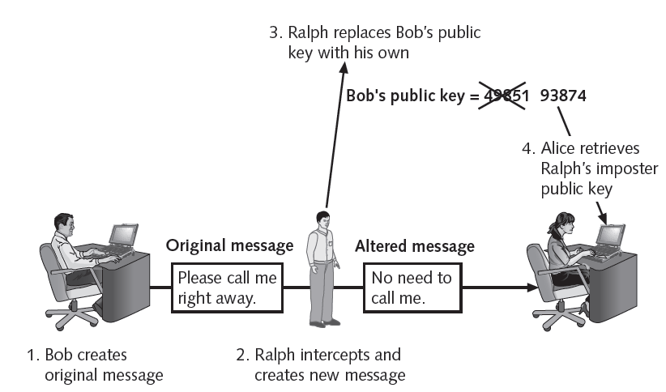
Digital Signature (cont’d)

Slide 17
Encryption Through Software
File and file system cryptography
Encryption software can be applied to one or many files
Protecting groups of files
Based on operating system’s file system
Pretty Good Privacy (PGP)
Widely used asymmetric cryptography system
Used for files and e-mails on Windows systems
GNU Privacy Guard (GPG)
Runs on Windows, UNIX, and Linux

Slide 18
Encryption Through Software (cont’d.)
PGP and GPG use both asymmetric and symmetric cryptography
Microsoft Windows Encrypting File System (EFS)
Cryptography system for Windows
Uses NTFS file system
Tightly integrated with the file system
Encryption and decryption transparent to the user
Users can set encryption attribute for a file in the Advanced Attributes dialog box

Slide 19
Encryption Through Software (cont’d.)
Whole disk encryption
Protects all data on a hard drive
Example: BitLocker drive encryption software

Slide 20
Diffie-Hellman
A key exchange algorithm, not an encryption algorithm
Allows two users to share a secret key securely over a public network
Once the key has been shared
Then both parties can use it to encrypt and decrypt messages using symmetric cryptography

Slide 21
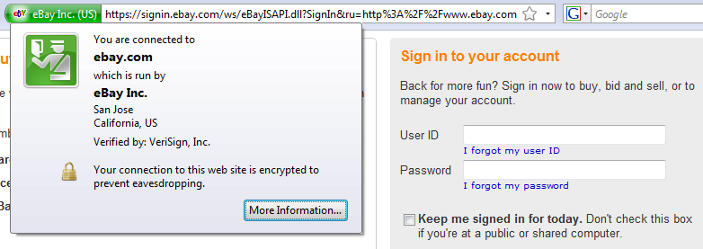
HTTPS
Secure Web Pages typically use RSA, Diffie-Hellman, and a symmetric algorithm like RC4
RSA is used to send the private key for the symmetric encryption

Slide 22
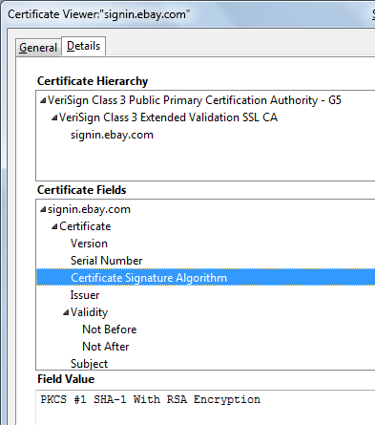
RSA Used by eBay

Slide 23
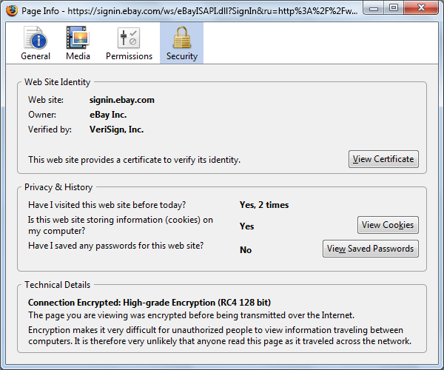
RSA Used by eBay

Slide 24
Questions

